Slide 1

“UI and various
components using react”
Task - 2

Slide 2
UI AND VARIOUS COMPONENT USING REACT:
TEAM MEMBERS:
LMS Username | Name | Batch
2113a53226 | DHNAUSHPRAKSH V C | Group_A53_4
2113a53240 | KESHNI M R | Group_A53_4
2113a53212 | AKSHARAA R | Group_A53_4
2113a53247 | MUGULSUNGAR S | Group_A53_4

Slide 3
INTRODUCTION:
User Interface (UI) refers to the visual and interactive elements of a software application, website, or digital product that users can see and interact with. The user interface plays a crucial role in determining the user experience and usability of a product. A well-designed user interface can make a product easy to use, engaging, and intuitive for users.
React is a popular JavaScript library for building user interfaces. It allows developers to create reusable UI components that can be used across different parts of an application. React uses a virtual DOM (Document Object Model) that makes it efficient and fast for rendering UI elements.
In this tutorial, we will explore various components that can be implemented using React. We will cover components such as buttons, forms, input fields, navigation bars, and more. We will also use various React features such as hooks, state, and props to build interactive and dynamic UI components.
Let's get started by setting up our development environment and installing the necessary dependencies.

Slide 4
Various Front End Programs:
FOR CALCULATOR :
index.html
<!DOCTYPE html>
<html>
<head>
<title>Calculator</title>
<link rel="stylesheet" href="style.css">
</head>
<body>
<div class="calculator">
<div class="display">
<input type="text" id="result" readonly>
</div>
<div class="buttons">
<button class="operator" onclick="input('+')">+</button>
<button class="operator" onclick="input('-')">-</button>
<button class="operator" onclick="input('*')">*</button>
<button class="operator" onclick="input('/')">/</button>
<button onclick="input('7')">7</button>
<button onclick="input('8')">8</button>
<button onclick="input('9')">9</button>
<button onclick="input('4')">4</button>
<button onclick="input('5')">5</button>
<button onclick="input('6')">6</button>
<button onclick="input('1')">1</button>
<button onclick="input('2')">2</button>
<button onclick="input('3')">3</button>
<button onclick="input('0')">0</button>
<button onclick="clearResult()">Cr</button>
<button onclick="calculate()">=</button>
</div>
</div>
<script src="script.js"></script>
</body>
</html>

Slide 5
font-size: 20px;
border-radius: 5px;
margin: 5px;
cursor: pointer;
}
.operator {
background-color: #ff9a00;
color: #fff;
}
.buttons button:nth-child(14) {
background-color: #ff9a00;
color: #fff;
}
.buttons button:nth-child(15) {
background-color: #007aff;
color: #fff;
}
.buttons button:last-child {
margin-right: 0;
}
.buttons button:focus {
outline: none;
}
.buttons button:active {
background-color: #ccc;
}
Various Front End Programs:
FOR CALCULATOR :
style.css
.calculator {
margin: 0 auto;
padding: 20px;
border: 1px solid #ccc;
border-radius: 5px;
width: 280px;
}
.display {
margin-bottom: 10px;
}
.display input[type="text"] {
width: 100%;
height: 40px;
border-radius: 5px;
padding: 5px;
font-size: 20px;
text-align: right;
}
.buttons button {
width: 50px;
height: 50px;

Slide 6
Various Front End Programs:
FOR CALCULATOR :
script.js
let result = document.getElementById('result');
function input(num) {
result.value += num;
}
function clearResult() {
result.value = '';
}
function calculate() {
result.value = eval(result.value);
}

Slide 7
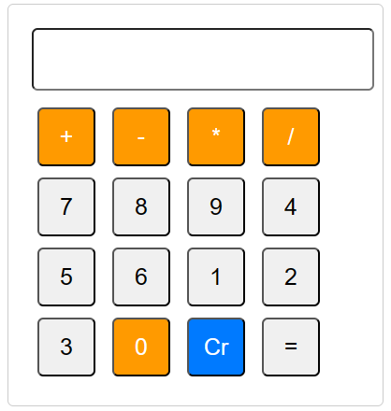
Various Front End Programs:
FOR CALCULATOR :
Output:

Slide 8
Various Front End Programs:
FOR TEXT EDITOR :
index.html
<!DOCTYPE html>
<html>
<head>
<meta charset="UTF-8">
<title>Innovative Text Editor</title>
<link rel="stylesheet" type="text/css" href="style.css">
</head>
<body>
<div class="editor">
<div class="toolbar">
<button class="bold"><b>B</b></button>
<button class="italic"><i>I</i></button>
<button class="underline"><u>U</u></button>
<select class="font-family">
<option value="Arial">Arial</option>
<option value="Helvetica">Helvetica</option>
<option value="Times New Roman">Times New Roman</option>
<option value="Courier New">Courier New</option>
</select>
<select class="font-size">
<option value="12px">12px</option>
<option value="14px">14px</option>
<option value="16px">16px</option>
<option value="18px">18px</option>
</select>
</div>
<div contenteditable="true" class="editable" spellcheck="false"></div>
</div>
<script src="script.js"></script>
</body>
</html>

Slide 9
Various Front End Programs:
FOR TEXT EDITOR:
script.js
.editor {
width: 500px;
height: 400px;
margin: 50px auto;
border: 1px solid #ccc;
padding: 10px;
box-sizing: border-box;
font-family: Arial, sans-serif;
}
.toolbar button, .toolbar select {
font-size: 16px;
border: 1px solid #ccc;
padding: 5px;
margin-right: 5px;
background-color: #fff;
cursor: pointer;
}
.editable {
height: 100%;
padding: 5px;
box-sizing: border-box;
border: none;
outline: none;
font-size: 16px;
font-family: Arial, sans-serif;
}

Slide 10
Various Front End Programs:
FOR TEXT EDITOR:
script.js:
const boldBtn = document.querySelector('.bold');
const italicBtn = document.querySelector('.italic');
const underlineBtn = document.querySelector('.underline');
const fontFamilySelect = document.querySelector('.font-family');
const fontSizeSelect = document.querySelector('.font-size');
const editableDiv = document.querySelector('.editable');
boldBtn.addEventListener('click', () => {
document.execCommand('bold', false, null);
});
italicBtn.addEventListener('click', () => {
document.execCommand('italic', false, null);
});
underlineBtn.addEventListener('click', () => {
document.execCommand('underline', false, null);
});
fontFamilySelect.addEventListener('change', () => {
const fontFamily = fontFamilySelect.value;
editableDiv.style.fontFamily = fontFamily;
});
fontSizeSelect.addEventListener('change', () => {
const fontSize = fontSizeSelect.value;
editableDiv.style.fontSize = fontSize;
});
editableDiv.addEventListener('input', () => {
const content = editableDiv.innerHTML.trim();
console.log(content);
});

Slide 11
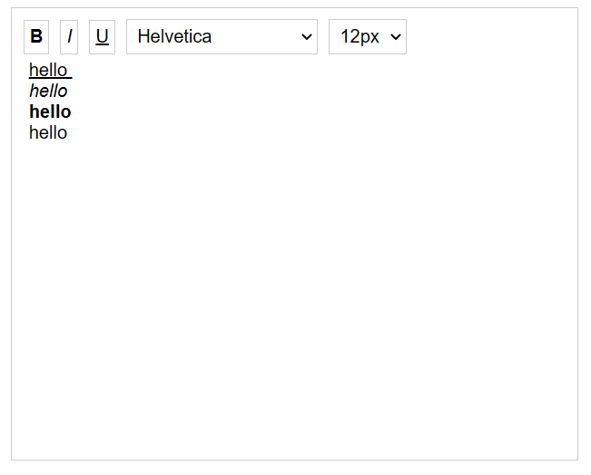
Various Front End Programs:
Output:

Slide 12
Step-Wise Description For Calculator:
Designing a front-end code for a text editor requires creating a user interface that allows users to create, edit, and save text files. Here are some steps to design a front-end code for a text editor:
Create the HTML structure for the text editor interface. This will include a text area for users to input and edit their text, and buttons or menu options to perform actions like save, open, and format the text.
Use CSS to style the text editor interface. This can include customizing the font, color, and layout of the text area and buttons.
Use JavaScript to handle the user input and perform the necessary actions. For example, you might create a function that saves the user's text input to a file when the save button is clicked, or a function that formats the text to a specific style when a menu option is selected.
Add error handling to your code to prevent the user from entering invalid inputs. For example, you might prevent the user from saving a file with an invalid file name or from opening a file that does not exist.
Test your text editor thoroughly to make sure it works as expected.

Slide 13
Step-Wise Description For Text Editor:
To design a uniform front-end code for a calculator, you need to consider the following factors:
User Interface: The user interface should be simple and easy to use. It should be designed in such a way that the user can easily input numbers and perform calculations. The design should also be visually appealing and consistent with the overall theme of the website or application.
Layout: The layout of the calculator should be logical and intuitive. The buttons should be arranged in a way that is easy to understand and use. You can group the buttons into categories such as numbers, operations, and other functions.
Functionality: The calculator should be able to perform all basic arithmetic operations such as addition, subtraction, multiplication, and division. It should also be able to handle decimals, percentages, and other advanced features like memory and scientific notation.
Error handling: The calculator should be able to handle errors such as divide by zero and invalid input. It should provide feedback to the user when an error occurs.
Responsiveness: The calculator should be designed to be responsive to different screen sizes and devices. It should be able to adjust its layout and design to fit the screen size and resolution of the device.
To achieve a uniform front-end code for the calculator, you can use a combination of HTML, CSS, and JavaScript. You can create a separate stylesheet for the calculator and use classes and IDs to style the elements. You can also use JavaScript to handle the user input and perform the necessary calculations.
Overall, a uniform front-end code for a calculator should be easy to use, visually appealing, and functionally robust. It should provide a seamless user experience and help users perform calculations quickly and accurately.

Slide 14
Assessment Parameter
Setup Project for Calculator project
Setup basic structure of text-editor project
Create a main component with the outer structure of calculator
Check-List for Calculator and Text Editor
Create main component with all feature buttons
Create a button component with on click handler
Create a json object to store data for text editor
Create a ` evaluateExpresion` function to evaluate value
Push both code to github

Slide 15
Submission Github
https://github.com/Mugulsundar/Naan-Mudhalvan/tree/main/TASK-2

